Slide 1

Parsa Darban
810100141
Spring 2025

Slide 2
Abstract
Addiction is a multidimensional phenomenon influenced by a combination of biological, psychological, and social factors. One of humanity's most important questions is: what happens in the body in response to addiction and the substances derived from drug use? Is it difficult to quit them? Can science advance to a point where we gain a deep understanding of this process, enabling us to help individuals overcome this habit more easily? Or even, could we find a substitute—such as a medication—with minimal side effects to replace it?

Slide 3
Introduction
The value of an experience or action is determined by the reward that follows it.
Addiction, at first glance, must hold a greater value in the brain than other activities. It is believed that certain long-lasting changes in synaptic plasticity are the underlying cause of addiction; these persistent changes lead to disruptions in the brain's reward system. Therefore, in addition to the brain, where decisions are made, there must also be a reward mechanism involved.
On the other hand, there is a psychological theory known as the opponent-process theory, proposed by Richard Solomon, which is considered one of the key frameworks for understanding individuals struggling with addiction.
In the following sections, we will explore the biological and psychological aspects of addiction, followed by an examination of the proposed model and the simulation results presented in the paper.

Slide 4
Biological Aspects
Dopamine is a neurotransmitter that plays a key role in generating the sensation of reward and reinforcing specific behaviors, such as drug use. Nicotine affects dopaminergic signaling in the Ventral Tegmental Area (VTA), a brain region that plays a vital role in the reward system and is involved in producing feelings of pleasure and learning from rewards (such as nicotine). Additionally, glutamatergic processes contribute to the automatic selection of behaviors that lead to nicotine consumption.
Moreover, brain synapses exhibit plasticity. In individuals with addiction, the way neurons communicate with one another undergoes changes. These alterations lead to a persistent tendency to engage in specific behaviors (such as smoking). This synaptic plasticity is considered one of the main factors in addiction, as it causes harmful behaviors to be performed automatically and uncontrollably.
The proposed model is also based on the following hypothesis:
“Nicotine addiction is a transition from impulsive behavior to compulsive behavior.”
That is, as a result of reinforcement learning, nicotine addiction gradually shifts from impulsive behaviors (performed randomly) to compulsive behaviors (performed unconsciously and repetitively).

Slide 5
Psychological Aspects
The opponent-process theory is a psychological and neurobiological theory used to explain emotional and motivational experiences in response to stimuli such as drugs, emotions, or intense experiences.
The opponent-process theory states that every intense emotional experience (such as pleasure or discomfort) is typically followed by an opposing emotional state. For example, nicotine initially produces a pleasant feeling (euphoria), but over time, an opposing process is activated (such as anxiety or intense craving), aiming to restore the body's emotional balance.
As a result, individuals continue using nicotine not for the initial pleasure, but to escape the negative state caused by the opponent process.

Slide 6
Model
So, two main approaches to explaining addiction — the opponent-process theory and reward-based learning — have been simultaneously considered in developing a computational model of nicotine addiction.
Reward-based learning is grounded in the principle that any action followed by a reward is more likely to be repeated in the future. This artificial reward causes the brain to learn that smoking is a highly valuable behavior, even if it leads to negative consequences. On the other hand, individuals continue using nicotine not for the initial pleasure, but to relieve the negative emotional state caused by the opponent process.
The modeling is based on two modules:
Action selection module, which is based on the functioning of the cortex–basal ganglia–thalamus loop.
DA signaling module, which has two components: An evaluation component that depends on the presence of nicotine.
A value-assignment component related to the reward received from the action and the prediction error, which is defined as the difference between the actual reward and the expected reward from performing the action.
Each of these modules is governed by differential equations, which will be presented in the following sections.

Slide 7

Action Selection
The Action Selection Module forms the core of the model, simulating how a behavior (such as smoking or not smoking) is chosen. This module consists of two main loops: the Premotor Loop and the Motor Loop, which together model the Cortex–Basal Ganglia–Thalamus (C-BG-TH) circuits.
The Premotor Loop is responsible for the planning and preparation of an action — it decides what action should be taken and how to prepare for it, before the action is actually executed. In contrast, the Motor Loop is directly responsible for the execution of that planned action, producing the actual physical behavior.
Premotor Loop State Variables | Description
$$p_{pm}\left(k\right)/p_{m}(k)$$ | Activity in the Premotor/Motor pathway.
$$m_{pm}(k)/m_{m}(k)$$ | Activity of the Premotor/Motor circuits.
$$r_{pm}(k)/r_{m}(k)$$ | Activity related to striatal influence.
$$n_{pm}(k)/n_{m}(k)$$ | Neuronal activity in the Premotor/Motor area.
$$d_{pm}(k)/d_{m}(k)$$ | Activity related to the diffuse effect of the subthalamic nucleus in the Premotor/Motor area.

Slide 8

Action Selection Equations
Premotor
$$p_{pm}\left(k+1\right)=f(λp_{pm}\left(k\right)+m_{pm}\left(k\right)+{W_{c}}_{pm}I(k))$$
$$m_{pm}\left(k+1\right)=f\left(p_{pm}\left(k\right)−d_{pm}\left(k\right)\right)$$
$$r_{pm}\left(k+1\right)={W_{r}}_{pm}f(p_{pm}(k))$$
$$n_{pm}\left(k+1\right)=f(p_{pm}(k))$$
$$d_{pm}\left(k+1\right)=f({W_{d}}_{pm}n_{pm}\left(k\right) −r_{pm}(k))$$
Motor
$$p_{m}\left(k+1\right)=f(λp_{m}\left(k\right)+m_{m}\left(k\right)+βp_{pm}+noise)$$
$$m_{m}\left(k+1\right)=f\left(p_{m}\left(k\right)−d_{m}\left(k\right)\right)$$
$$r_{m}\left(k+1\right)={W_{r}}_{m}f(p_{m}(k))$$
$$n_{m}\left(k+1\right)=f(p_{m}(k))$$
$$d_{m}\left(k+1\right)=f({W_{d}}_{m}n_{m}\left(k\right) −r_{m}(k))$$
f is activation function.
$$f\left(x\right)=\frac{1+tanh⁡(a(x−0.45))}{2}$$

Slide 9

Action Selection Equations
The equations of the Action Selection Module, which include the Premotor and Motor loops, model the neural dynamics involved in behavioral decision-making. These equations use nonlinear activation functions (f ) to simulate how sensory inputs (I(k)) are processed, how internal brain activities (such as $p_{pm}$, $p_{m}$, $m_{pm}$, $m_{m}$) are regulated, and how various brain structures — such as the subthalamic nucleus (via $W_{d}$) and the striatum (via $W_{r}$) — exert their influence.
The ultimate goal of these equations is to select an action (e.g., to smoke or not to smoke), with the decision determined by the output activity of $p_{m}.$
The model parameters are as follows:
λ : This parameter (with a value of 0.5) controls the self-feedback of activities ppm and pm within the Premotor and Motor loops, respectively.
β : This parameter (with a value of 0.03) determines the influence and connection of ppm activity (from the Premotor loop) on pm activity in the Motor loop
a: This parameter (with a value of 3) adjusts the slope of the activation function f, which is used to introduce nonlinearity into the system.

Slide 10

DA Signaling Module Equations
The Dopamine Signaling Module (DA Signaling Module) in the proposed model is a crucial component responsible for processing reward signals and nicotine-related cues. This module, which is activated in the presence of nicotine, consists of two main components: Action Evaluation and Value Assignment.
The Action Evaluation component operates based on the presence of nicotine, while the Value Assignment component calculates the rewards assigned to actions and the prediction error. This module guides the Action Selection (A-S) loop by representing the rewarding value of previously performed actions.
Updates the phasic dopamine activity
$$u_{DA}\left(k+1\right)=u_{DA}\left(k\right)+μ_{DA}(−u_{DA}\left(k\right)+s_{DA}(ri,Ni))$$
$$s_{DA}=\frac{1+tanh⁡(Ni×ri −θ_{DA})}{2}$$
Value signal representing the system's evaluation of the current performed action
$$V\left(k\right)={(W}_{v}+base)(I(k))$$
Reward prediction error, which is the discrepancy between the immediate reward
$$δ\left(k\right)=ri\left(k\right)+μV\left(K+1\right)−V(k)$$

Slide 11

N-S-C Dynamics
The N-S-C dynamics is an internal subsystem within the model, consisting of three state variables: n(k), s(k), and c(k). This system forms a set of nonlinear difference equations that model the changes in these variables over time. These variables are automatically updated in response to both the external nicotine level and the complex interactions among themselves. The primary goal of this component is to simulate the fundamental neural processes involved in the absorption and processing of nicotine in the brain.
The N-S-C dynamics is directly connected to the dopamine signaling (DA) module, as its output serves as a critical input for that module. Specifically, the variable Ni (nicotine absorption), which is used to compute the dopamine activation signal ($s_{DA}$), is derived from the product of n and s (when nicotine administration is stopped). This connection ensures that the presence and processing of nicotine in the neural system directly influence dopamine activity, and thus impact reward processing and reinforcement learning. In this way, the N-S-C Dynamics provides the physiological foundation for nicotine’s effect on the brain's reward mechanisms and links it to the DA module.

Slide 12

N-S-C Dynamics Equations
$$n\left(k+1\right)=n\left(k\right)+\frac{μ}{τ_{n}}[−β_{n}\left(k\right)c\left(k\right)+α_{n}(k)(1 −n\left(k\right)c\left(k\right))]$$
$$s\left(k+1\right)=s\left(k\right)+\frac{μ}{τ_{s}}[−β_{s}s\left(k\right)+α_{s}(k)(1 −s\left(k\right))]$$
$$c\left(k+1\right)=c\left(k\right)+\frac{μ}{τ_{c}}[−β_{c}c\left(k\right)+α_{c}(k)(1 −c\left(k\right))]$$
Activation functions:
$$α_{n}\left(k\right)=0.5(1+tanh⁡(nicotine −θ_{n}))$$
$$α_{s}\left(k\right)=0.5(1+tanh⁡(n(k) −θ_{s}))$$
$$α_{c}\left(k\right)=0.5(1+tanh⁡(s(k) −θ_{c}))$$
$$β_{n}\left(k\right)=0.5(1+tanh⁡(c(k) −θ_{n}))$$
We present a table of the parameters and their initial values below.

Slide 13
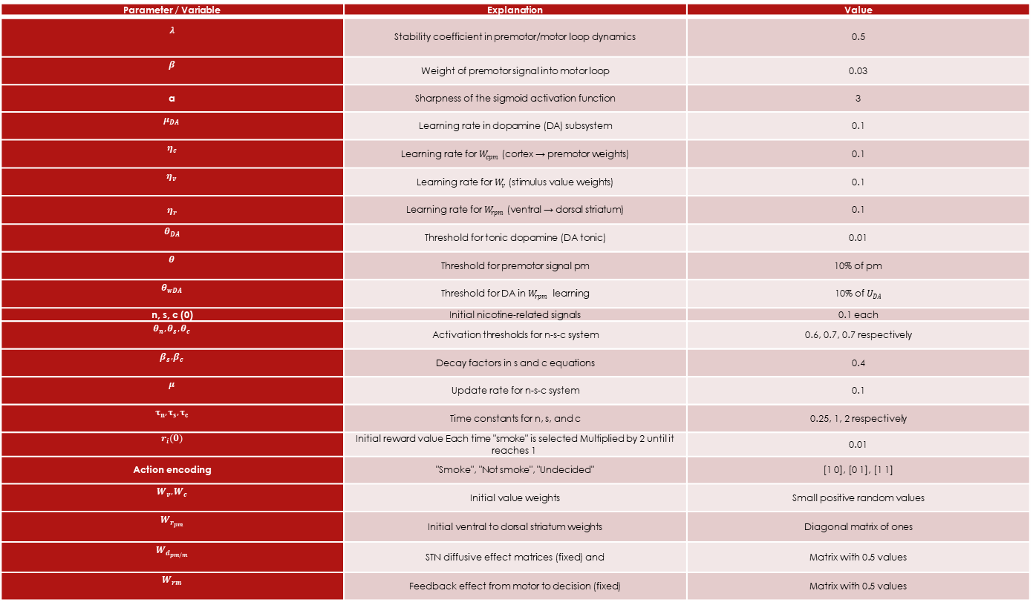
Variable & Parameters Table
Parameter / Variable | Explanation | Value
$$λ$$ | Stability coefficient in premotor/motor loop dynamics | 0.5
$$β$$ | Weight of premotor signal into motor loop | 0.03
a | Sharpness of the sigmoid activation function | 3
$$μ_{DA}$$ | Learning rate in dopamine (DA) subsystem | 0.1
$$η_{c}$$ | Learning rate for $W_{cpm}$ (cortex → premotor weights) | 0.1
$$η_{v}$$ | Learning rate for $W_{v}$ (stimulus value weights) | 0.1
$η_{r}$​ | Learning rate for $W_{rpm}$ (ventral → dorsal striatum) | 0.1
$$θ_{DA}$$ | Threshold for tonic dopamine (DA tonic) | 0.01
$$θ$$ | Threshold for premotor signal pm | 10% of pm
$$θ_{wDA}$$ | Threshold for DA in $W_{rpm}$ learning | 10% of $U_{DA}$
n, s, c (0) | Initial nicotine-related signals | 0.1 each
$$θ_{n},θ_{s},θ_{c}$$ | Activation thresholds for n-s-c system | 0.6, 0.7, 0.7 respectively
$$β_{s},β_{c}$$ | Decay factors in s and c equations | 0.4
$$μ$$ | Update rate for n-s-c system | 0.1
$$τ_{n}, τ_{s}, τ_{c}$$ | Time constants for n, s, and c | 0.25, 1, 2 respectively
$$r_{i}(0)$$ | Initial reward value Each time "smoke" is selected Multiplied by 2 until it reaches 1 | 0.01
Action encoding | "Smoke", "Not smoke", "Undecided" | [1 0], [0 1], [1 1]
$$W_{v},W_{c}$$ | Initial value weights | Small positive random values
$$W_{r_{pm}}$$ | Initial ventral to dorsal striatum weights | Diagonal matrix of ones
$$W_{d_{pm/m}}$$ | STN diffusive effect matrices (fixed) and | Matrix with 0.5 values
$$W_{rm}$$ | Feedback effect from motor to decision (fixed) | Matrix with 0.5 values

Slide 14
Result
To evaluate the performance of the proposed nicotine addiction model, the system's response to nicotine uptake was simulated. The initial reward value was set very low and increased with each selection of the "smoking" action until it reached 1. The simulation stops when the smoking action is selected 20 times in a row, which is considered an indication of addiction. In 20 out of 50 runs, addiction was established. The average number of trials required to reach addiction was 346, with a standard deviation of 265.7. These results indicate that the model is capable of representing the process of addiction development.
Reinforcement error signal δ when addiction is a) set up b) not set up

Slide 15
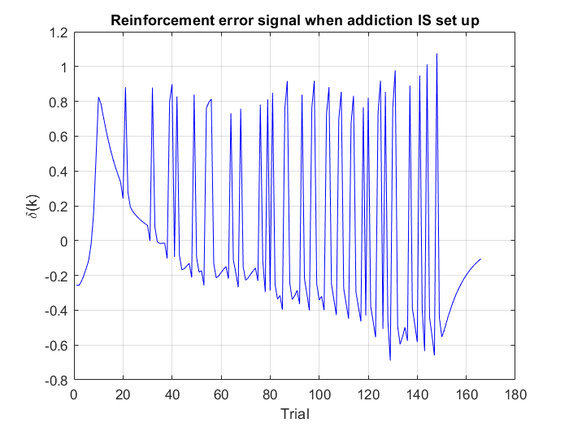
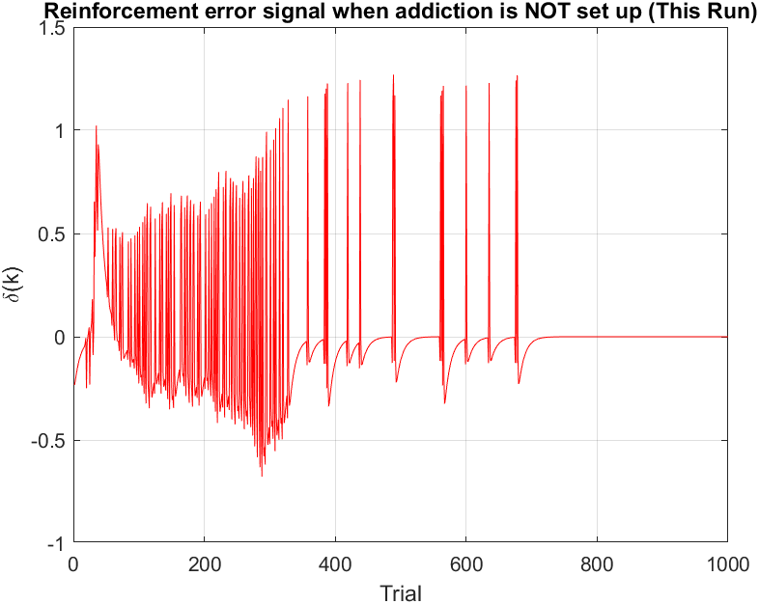
Simulation
The simulation of this paper was implemented by myself due to the unavailability of the original code. The implementation file is included in the uploaded materials. Modeling brain processes such as addiction requires repetition because of their complexity, nonlinearity, and stochastic nature, in order to obtain reliable and generalizable results. This is why each run of the code may yield different outcomes. Additionally, criteria such as 20 consecutive smoking actions and the use of variance-based metrics are employed precisely because of this relative randomness.
The simulation results are as follows:(In the next slide, we will analyze it.)

Slide 16
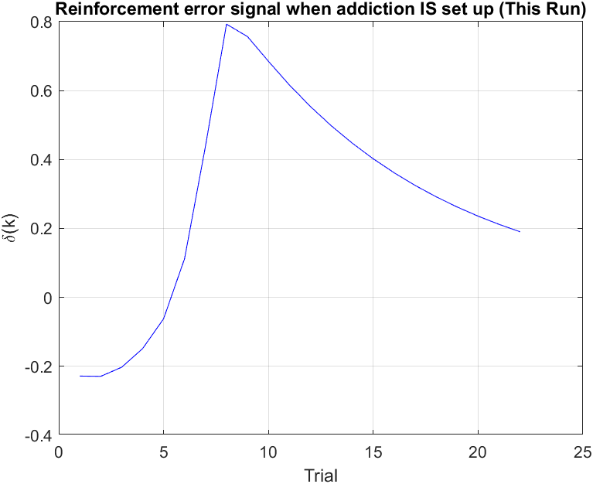
Simulation
The initial negative value of δ may indicate that the received reward was less than expected, or that the system's initial expectations are still being adjusted. The rapid increase of δ toward positive values, reaching a peak, represents a significant positive reward prediction error—likely due to the selection of the "smoking" action and receiving a reward that exceeded the initial expectation (since ri starts at 0.01 and doubles with each selection). On the other hand, the subsequent decrease in δ implies that the agent is gradually learning to correctly predict the value of the "smoking" action, and the difference between expected and received reward is diminishing. In other words, the agent has "learned" that smoking provides a high reward and is no longer "surprised." This decrease and convergence of δ toward zero signals the stabilization of addictive behavior and the transition from random choice to compulsive behavior, as the system consistently and confidently selects the rewarding action.
The simulation results are as follows:(In the next slide, we will analyze it.)

Slide 17
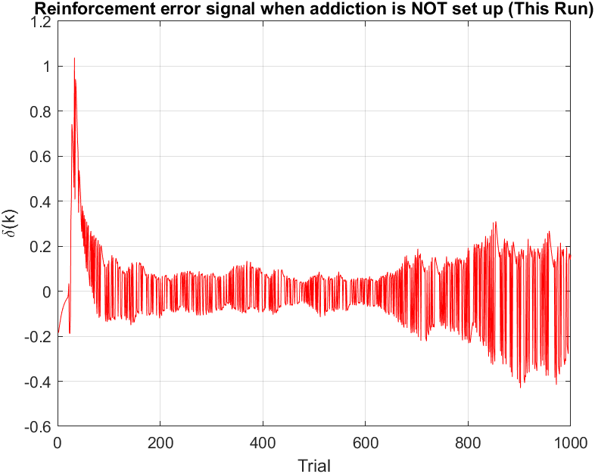
Simulation
The initial peak and strong fluctuations indicate the system’s early attempts to learn and adjust its reward expectations. Large reward surprises (both positive and negative) occur during this phase, as the system is still exploring the relationship between actions and rewards. The failure of δ to converge toward zero suggests that the model was unable to stabilize a consistent, "addictive" behavior (i.e., selecting the smoking action 20 times in a row). The system continues to experience reward prediction errors and cannot consistently predict the value of a specific action (like smoking) with high accuracy. These persistent fluctuations indicate that the system remains in a state of exploration or uncertainty and has not reached a level of "compulsive learning" that would lead to addiction.

Slide 18
Conclusion
This study presents an advanced model of nicotine addiction based on the cortico-striato-thalamic (A-S) circuit, which is modulated by the effect of nicotine on dopamine signaling. The model includes two loops—premotor and motor—for action selection and evaluation. Unlike previous models, it employs a dynamical system that incorporates past experiences into decision-making. Additionally, a novel circuit called n-s-c is introduced to simulate nicotine uptake. The main goal of this model is to demonstrate the role of goal-directed learning in the development of addiction.

